Slide 1

Sustainable Food Value Chain for
Food Security in Arena of Climate Change
National Workshop On “Food Security and Climate Change”
Tuesday, 2 June, 2015
Anand Agricultural University, Anand, Gujarat
HETAL C SEJU
NCCSD

Slide 2


Sustainable Food Value Chain
National Council for Climate Change, Sustainable Development and Public Leadership
Currently a Food Value Chain exists
It operates for
Small farmers – to local traders – APMC – wholesaler – retailers – consumers
Big farmers - APMC – wholesaler – retailers - consumers
Milk in Gujarat
Animal holder – milk produce societies – district union – market federation

Slide 3
National Council for Climate Change, Sustainable Development and Public Leadership
But current value chain does not pay attention to losses harvesting – to marketing – up to consumer level – these range from 5% to 25%
If they are plugged, farmers can get increased income by 5% to 25% . So will be food stock enhanced by same percentage.
This help both – Sustainable Livelihood and Food Security

Slide 4
Causes of food losses and waste
National Council for Climate Change, Sustainable Development and Public Leadership
Food is mostly lost and wasted, because of the way food is:
• produced;
• handled after harvest;
• stored;
• preserved; and
• processed
Transported
In addition, food is lost and wasted due to people’s lack of access to better market as a result of:
• insufficient income;
• forced to make sale to local traders cum money lender – for example in Gujarat 54% farmers are indebted while in Andhra Pradesh is 84%
• lack of or inadequate infrastructure, such as roads, railways, waterways, port infrastructure.
Lack of facility of bulk transport at local level

Slide 5
National Council for Climate Change, Sustainable Development and Public Leadership
With the end users – consumers it is due to :
how food is stored;
prepared and cooked; in case of vegetable and fruits – how it is sliced and
Wastage due to people buying more food than they need, take more food in their plates than they can eat – leave residue in the plate and finally throw all these in garbage.

Slide 6
Food production stage
National Council for Climate Change, Sustainable Development and Public Leadership
Vegetable commodities and products
Pre-harvest cultivating and harvesting practices influence the post-harvest life of products due to decisions made regarding what, when and how to plant and when to harvest (FAO, 1998).
Pre-harvest – this includes selection crop, quality of seeds, cultivation practices, quantity of water, type of soil all affect post-harvest quality, shelf life and post-harvest losses. The selection of crop should be based on soil fertility and farmers should be guided by soil health analysis.
Good post-harvest practices can also prolong the post-harvest life particularly of fruits and vegetables.
Sometimes food may be lost due to premature harvesting as farmers may decide to harvest crops earlier, because they are food insecure or need to generate income.
It may also happen that harvesting is undertaken too late or that losses occur during harvesting due to damage and/or spillage.

Slide 7
National Council for Climate Change, Sustainable Development and Public Leadership
Smart agricultural practices and rules of harvesting
Smart agricultural practices involve adequate soil management, selection of crop which soil fertility can support, use of certified seeds, management of weeds, crop protection and maintenance of crop hygiene.
The latter involves the collection and removal of decaying plants, fruits and weed that can lead to infections in vegetables and fruits, which may result in post-harvest losses and waste.
The basic rules of harvesting with the aim to get the crops in the best possible condition to the market are:
harvest during the lowest temperature of the day: early morning or late afternoon;
do not harvest produce when it is raining or when there is dew, when the produce is wet it is more likely to decay as well as it is more vulnerable to damage; and
make sure to protect the harvested produce from sunlight if it cannot be immediately transported.

Slide 8
Post-harvest handling and food storage stage and food processing stage
National Council for Climate Change, Sustainable Development and Public Leadership
Vegetable commodities, livestock and dairy products and fish commodities
Food losses and waste of crop, livestock and fish products at the post-harvest handling & storage stages and at the processing stage may occur due to:
spoilage, as a result of lack of or inadequate cooling facilities and lack of adequate infrastructure for transportation;
spillage, contamination, and degradation are a result of poor and inadequate handling during transport and storage. They are also due to processing, such as during washing, peeling, slicing and boiling of fruits, vegetables.
inadequate preservation of the products;
• packaging, as a result of damaging due to use of poor quality containers.
(FAO, 1989; Parfitt et al., 2010; FAO, 2010b; FAO, 2011d)

Slide 9
National Council for Climate Change, Sustainable Development and Public Leadership
Good post-harvest handling and storage practices
A variety of practices and technologies are available for reducing post-harvest losses related to post-harvest handling and storage. Good handling practices in order to avoid mechanical damages include ensuring that:
Bags are not too full if they need to be stacked on top of each other;
Bags are not dropped or thrown;
produce is not directly put on the soil, in particular soil with a high moisture content;
containers and field containers are clean;
the produce is not brought into contact with oil, gasoline or chemicals that should not be applied;
produce is largely kept in the shade to reduce the temperature of fresh produce;
produce is field packaged, which reduces costs by improving the speed of post-harvest handling and reduces losses and waste
(FAO, 1989)

Slide 10
National Council for Climate Change, Sustainable Development and Public Leadership
Other possible interventions to reduce food losses include:
immediate transportation after harvesting of crops, and landing in the case of fish;
using improved preservation and processing techniques including threshing and solar drying of produce;
using low cost and efficient storage and cooling structures; and
using practices, i.e. pasteurization and milk processing into cheese and yoghurt, to maintain product quality and extend post-harvest life.

Slide 11
Public Distributions System
National Council for Climate Change, Sustainable Development and Public Leadership
In our country government buys food grains and makes available through fare price network – at a specified price – which is subsidized to poor families.
This system involves – procurement, packing, transportation to storage – godowns and from there to retail FPS.
Entire system needs modern management and practices to reduce transportation losses, storage losses and spoilage – which is huge.

Slide 12
Public actions to support food chain interventions to reduce, reuse or recycle food stuffs
National Council for Climate Change, Sustainable Development and Public Leadership
Government can not directly reduce, reuse or recycle food stuffs produced by farmers but certainly can guide the farmers to change management practices, technologies and behavior in order to reduce, reuse or recycle their produce and create an enabling environment.
Set an example by itself by reducing godown and transits losses in public distribution system and including re-cycle use of wastage.
Creating a policy and institutional enabling environment for incentivizing reduction in losses
Awareness raising and advocacy for reuse – recycle waste – agro, cow dung and urine, and food

Slide 13
National Council for Climate Change, Sustainable Development and Public Leadership
Building partnerships and alliances by promoting women self help groups for village level group market and local processing, encouraging and assisting youth to set-up micro-enterprise and adapt modern agricultural practices.
Supporting product and process innovation and research at the stage assign specific responsibilities to agricultural universities
Capacity development – farmers, godown maneger, APMC managers and even housewives.

Slide 14
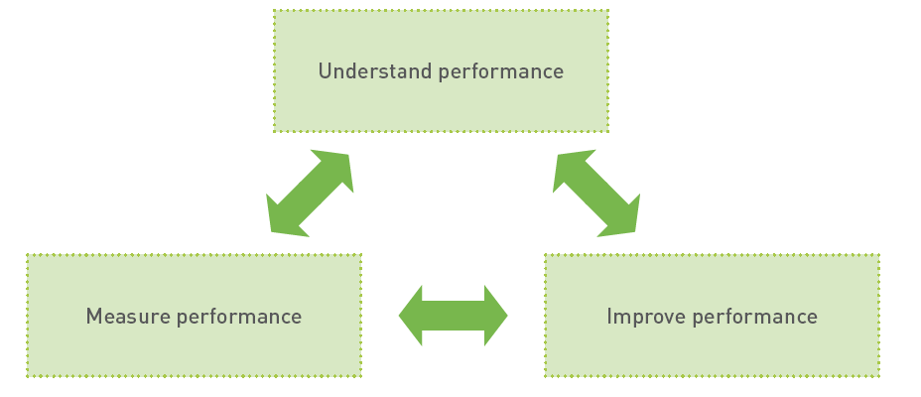
Step-by-step approach for chain actors to improve their performance along the sustainable and inclusive food value chain
National Council for Climate Change, Sustainable Development and Public Leadership
The three steps are visually outlined below in Figure
Step-by-step approach for how to improve performance along the sustainable and inclusive food value chain

Slide 15
Case Studies
National Council for Climate Change, Sustainable Development and Public Leadership

Slide 16
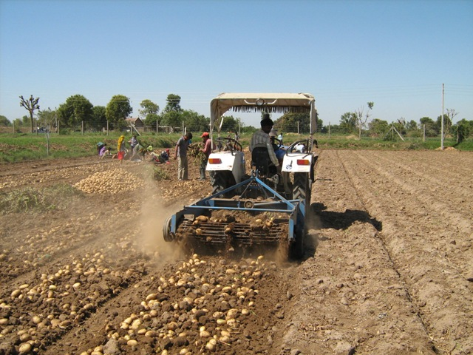
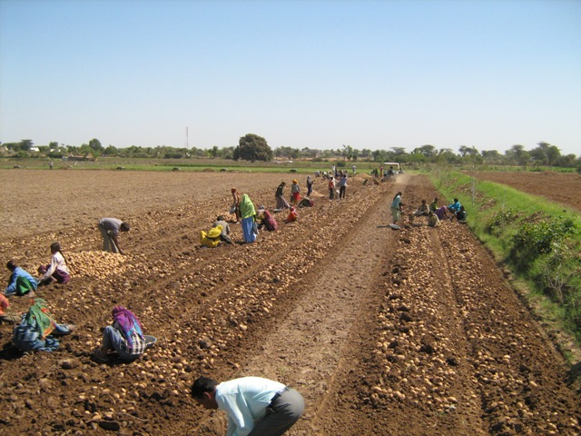
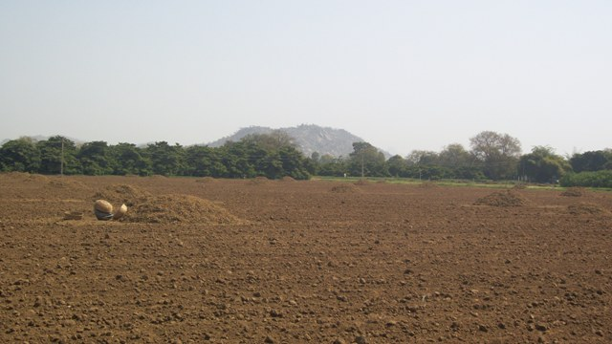
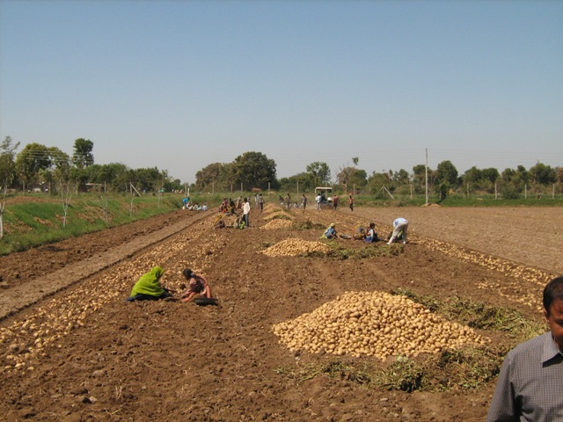
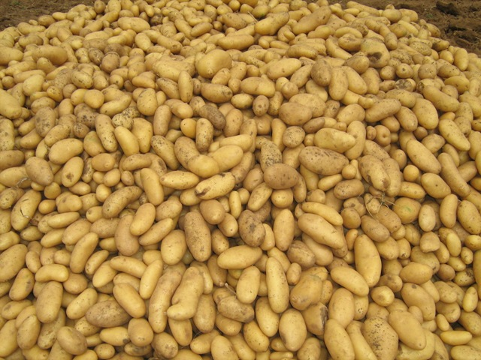
National Council for Climate Change, Sustainable Development and Public Leadership
McCain is an International Food Multinational Company. It selected Gujarat for its potato operations about 14 years back.

Slide 17
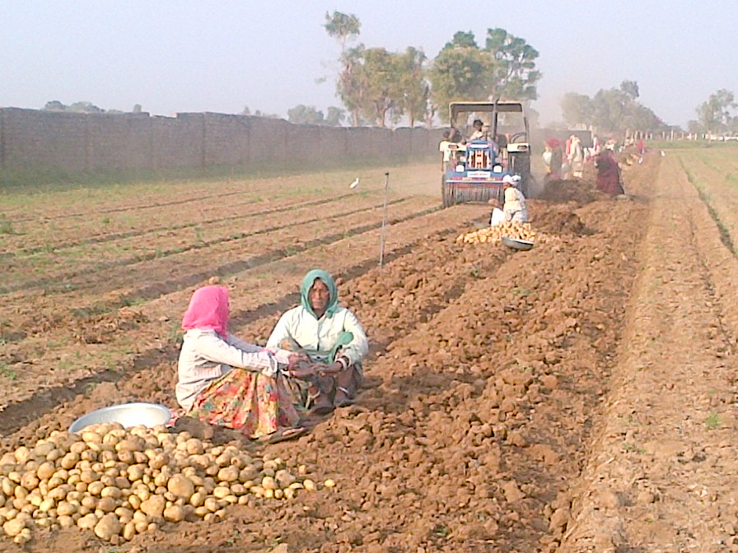
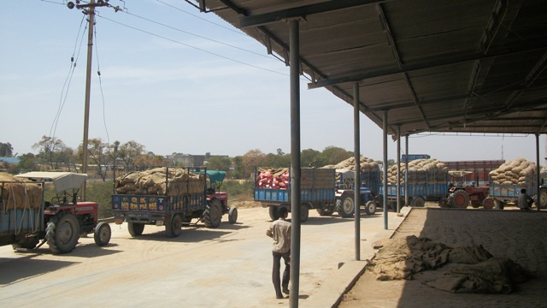
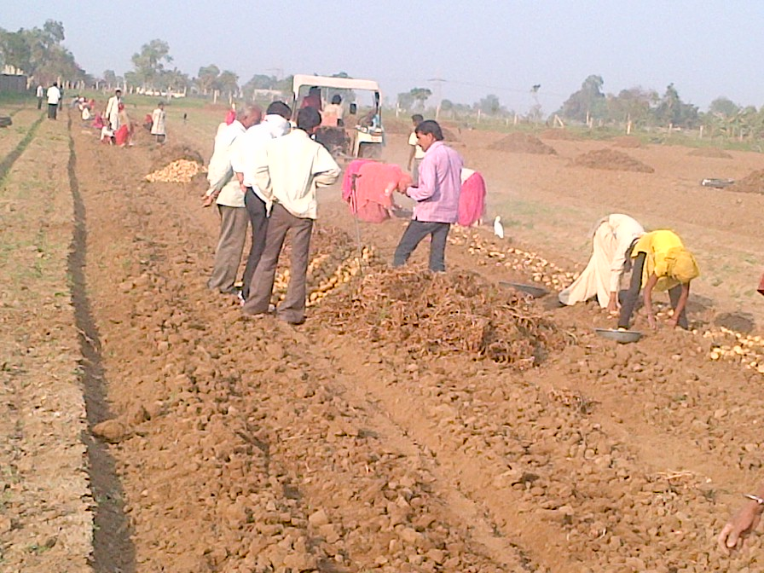
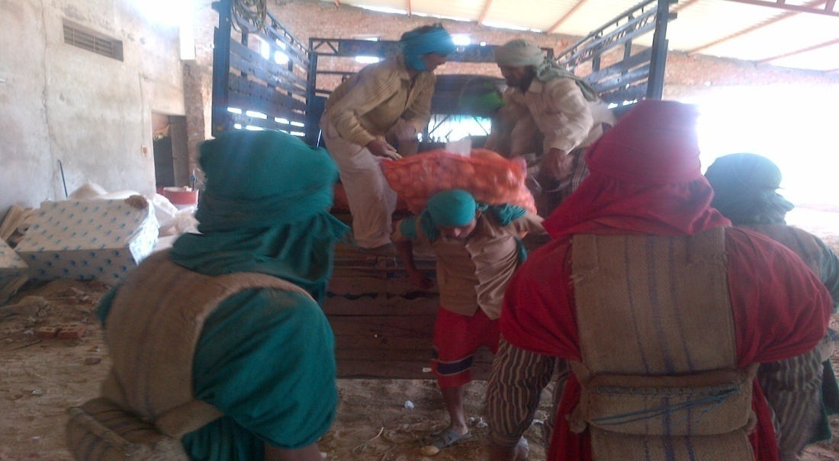
Harvesting and Storage Loading
National Council for Climate Change, Sustainable Development and Public Leadership

Slide 18
Our focus has been on Contract farming. This is a win : win situation for the farmers and McCain.
National Council for Climate Change, Sustainable Development and Public Leadership
To The Contract Growers
Exposure to world class mechanized agro technology
Obtains an assured up front price and market outlet for this produce.
Crop monitoring on a regular basis. Technical advice, free of cost at his doorstep.
Supplies of healthy disease free seeds
Remunerative returns
Agri. technology spreads to other crops and to farmers who are not under “Buyback farming”.
To McCain.
Uninterrupted and regular flow of raw material.
Clarity on prices in advance
Minimizing the unproductive middlemen.
Builds long term commitment improvement in quality.
Dedicated supplier base.
Traceability of product.
Notes:
Slow and try to
Reference foltrida and texas
High temp. during post harvest can exceed 45 C
Both table and seed potatoes are stored at same temperatures
UP 463 th ha, WB-315 th ha, Pb. 75 th ha and MP 62 th ha, Bihar 175 th ha, Karnataka 32 th ha and Maha 20 ths

Slide 19
JAOL Current Farmers Support Programmes
Jayant Agro Ltd., Banaskantha, Gujarat
National Council for Climate Change, Sustainable Development and Public Leadership
Objective
To make farmer aware about scientific farming of castor seeds and value added Agri-produce to realize
Maximum return from farming and
Achieve sustainable livelihood.
The Chairman JAOL’s vision to make farmers – stakeholders in real sense and support them to achieve better quality of life.

Slide 20
National Council for Climate Change, Sustainable Development and Public Leadership
Capacity building programme for scientific cultivation of castor including selection of quality seeds, balance use of fertilizers based on Soil Health Analysis
Guidance about harvesting
- Time
- Method
Grading
Cleaning of castor seeds
Sorting
To realize maximum value of castor seeds .JAOL has interacted with over 500 farmers .

Slide 21
Value Added Agriculture
National Council for Climate Change, Sustainable Development and Public Leadership
JAOL is purchasing castor seeds at farmers’ door step
It provides them price of the day which is prevalent in the market
It provides bags for packaging and cleaning equipment
It assists farmers to form group – village association so that a truck load of seeds can be sent
Farmers have got price of castor seeds which prevalent in Deesa Market in their own village

Slide 22
National Council for Climate Change, Sustainable Development and Public Leadership
Thank You
National Council for Climate Change, Sustainable Development
and Public Leadership (NCCSD)
Patel Block, Rajdeep Electronics Compound, Stadium Circle,
Navrangpura, Ahmedabad – 380 014. Gujarat, INDIA.
Phone: + 91 79-26421580 (Off)
Email: info@nccsdindia.org Website: www.nccsdindia.org

