Slide 1




Future Agriculture
Women Farmers – New Farmers – Sustainable Livelihood & Development with Technology
National Council for Climate Change Sustainable Development and Public Leadership (NCCSD) Patel Block, Rajdeep Electronics Compound, Near Stadium Six Road, Navrangpura, Ahmedabad-380 014 Website: www.nccsdindia.org

Slide 2
Women Farmers – New Farmers Future Agriculture in Viksit Bharat
1. Structural Change at the Family Level in Rural Areas
Traditionally, men take all farming decisions while women contribute labour – treated as workers.
With men increasingly migrating to semi-urban and urban areas for work and youth for studies, in many areas, women are now emerging as the ‘New Farmers’ and have to become responsible for day-to-day agricultural decisions.
Women are not well-informed about current agricultural practices – technology and assistance available.
Extension Administration does not contact them.
Their mobility outside village is limited.
Majority of them do not have smart phones.
2. Structural Change in Agriculture Sector
Climate change and unpredictable intense adverse weather events need continuous guidance and farmer-specific contingency planning – productivity is under challenge – so is livelihood.
Shrinking farm size make viability a challenge; while technologies for tiny farms exist, it remains inaccessible to most farmers.
Increasingly “Sharecroppers” are growing in peripheral areas of Urban – Semi Urban towns which is a major challenge to productivity. This is different from sugar cane farming. Land is sold – but not developed by speculators and hence sharecroppers.
Salinity ingress and water contamination - in tubewells and canal water further aggravates the situation, threatening both crops’ livestock and drinking water – productivity and health. Ocean areas already face serious challenges.
Adaption of Prakrutik Kheti is need of time – due to soil degradation and increasing cost of chemical inputs.

Slide 3
3. Support Women farmers for VIKSIT BHARAT.
In VIKSIT BHARAT, Agriculture Sector is a major strength. India, with world’s second largest arable land and adaptive farmers can supply World Food and Food Security as it already did during arena of COVID.
But to make this happen Agricultural Administration and Universities have to make a paradigm shift in their focus.
Women already look after livestock and understand its use and more adaptive and willing to pick up new ideas. But they need to be informed and guided by demonstration an up-skilled for New Technologies and emerging climate change situation and market trends – more particularly:
Water Resilient Agriculture
Smart use of Water and Solar System.
Digital use – For application for Subsidy & Loan and Market & Procuring inputs.
Soil & Water analysis-based Crop Selection
Weather Advisory based farming and climate smart agriculture.
Use of Drone
Precision Agriculture
Tissue Culture
Contingency plan in case of severe adverse weather events.
4. Women Farmers need Attention and Support:
Extension Administration and Agricultural Universities must reach out to them at village level.
Financial support by Bank.
In village records – from VII – XII; they should be recorded as farmers and also in census as well in succession – VARSAI entries.
Support for smart phones and setting up of cooperatives / FPO
Guidance for –
Selection of inputs
Weather events & Climate Smart Agriculture
Harvesting and Storage
Marketing & Value addition

Slide 4
5. Social Transformation – Ease of doing Business for Women:
Structural change in family in Decision-taking process needs to be facilitated – by appropriate social media messages in TV, Newspapers, Radio and social media. Family must realise that they have to support and make it easy for them to work and decide.
Technology – tools and equipments are Men-centric. They have to be Women-centric also – but more importantly made available at village – block level.
Rotation system exists in Local bodies Gram Panchayat for chairperson – same need to be introduced in Cooperative and APMC by statutory amendments.
6. Learning from Gujarat’s Experience
Under the Krishi Mahotsav Approach, initiated by Hon’ble Prime Minister Shri Narendra Modi (then Chief Minister of Gujarat), the state successfully overcame the challenges of low productivity.
Today, Gujarat stands as a leading Agricultural, Animal Husbandry & Fisheries state, demonstrating how structured interventions can turn adversity into opportunity.
Gujarat Women have already made successful AMUL model. They look after 100 per cent livestock management and are adaptable but need to be up-skilled and supported.
In Viksit Bharat approach is to have increasing income of rural family on par with their urban counterparts -This will need of male member to work in non-agriculure farm work - within or outside villages.

Slide 5
Way Forward: Viksit Bharat – Atmanirbhar Farmers
Hon’ble Prime Minister has laid a roadmap for agriculture in his Independence Day address as part of Viksit Bharat.
With women farmers at the centre, a comprehensive national program is needed to address emerging challenges.
The Krishi Mahotsav model can be adapted for mass communication, awareness creation, and implementation.
Request to ONGC – to support Second phase of this program.
Request to NITI Aayog: Take this idea forward and design a framework for nationwide adoption.

Slide 6
Department of Agriculture has all below Schemes, which are very good – but non-implementable.
Some Public Governance Issues:
Drone Scheme:
However, this scheme is very useful. Farmers save input cost. Drone has limited battery life and need a transport to carry them. Drone application is limited to one or two forms - thereafter, have to be taken back for charging. Transport is expensive. Hence scheme is structurally defective. Perhaps can work if State Agro Industries Corporations can take this up under Tool Room Scheme and make available al local level – inclusive of transport and charger.
APMC - Cooperatives: One relates to sale of produce – second, Milk Producers Societies. Women have no representative in the Management Committee Board. They need to be made part of Governance System on par with local bodies where by rotation women are becoming Sarpanch, District Panchayat President.
Solar Scheme: The scheme for sale of surplus electricity, generated in farms, is most viable and provide assured income but it is not possible for all villages to connect to grid – and therefore, no sale takes place unless there is a local Sub-station – hence it is not feasible to sell electricity to Electricity Companies. Hence scheme has very limited impact although it is most useful and most environment friendly.
Kisan Credit Card: Women are not given this – despite there is provision to give them without being a land owner.
FPO Scheme: This is again structurally defective scheme. MD – Chairman runs the organization – but has no higher stake in investment as it is in Limited Companies where promoter has a high stake and investment. Again, once promoter becomes MD, rest of members have no say in Management and there is no rotation system.

Slide 7
Further there is no Apex body as it exists in AMUL model. It is good scheme but - has not taken off.
Agriculture Research Centres both of ICAR and State Agricultural Universities are doing well. But major issue is that they do not follow guidelines of Climate Resilient Agriculture, there is no smart use of water by drip nor solar energized equipments. Farmers voice this when we ask them to follow climate smart agriculture practices. Many centres even do not test soil and water

Slide 8
Background
Agriculture contributes 16% to India’s GDP and is increasingly a women-centric activity.
70–80% of rural women workers are engaged in farming or allied agricultural activities.
Women play a key role in sowing, weeding, harvesting, threshing, grain storage, fisheries, animal husbandry, and sometimes marketing.
In rural India, women form the most productive workforce, especially in developing regions.
Male outmigration for jobs and youth leaving villages for education → farming responsibility shifting entirely to women.
Women are now decision-makers, not just helpers → must be recognized as “New Farmers.”
Yet, most are officially identified as “Workers ” (in census report) not as “farmer.”

Slide 9
Status of Women Farmers in Agricultural
Data Snapshot
Indicator | Status
Rural women engaged in agriculture | >73%
Women with legal land ownership | 12.8%
Women with Kisan Credit Card | <7%
Women members in FPOs/PACS | <10%
Women with access to crop insurance | <5%
Women receiving agriculture training | <10%
Source: NSSO, NABARD, Agriculture Census, FAO

Slide 10
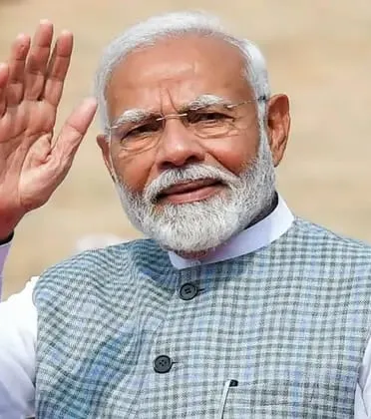
PM’s Vision: “Nari Shakti – Foundation of New India”
Core messages:
Women are not just helpers — they can lead the next agricultural revolution.
Recognize women as independent farmers, even without land ownership.
Focus Areas:
Recognition as ‘Farmer’ – Policy support for women without land titles.
Promoting SHGs & FPOs – Strengthening women-led producer groups.
Easy access to credit & insurance – Simplified KCC & PMFBY for women.
Women as agri-entrepreneurs – Support for organic farming, value addition, food processing.
Skill development – Training in machinery, animal husbandry, climate-smart agriculture.
Access to technology – Women-friendly tools, solar devices, mobile apps, drones.
Inclusion in schemes – Ensure direct participation in PM-Kisan, Digital India, etc.

Slide 11
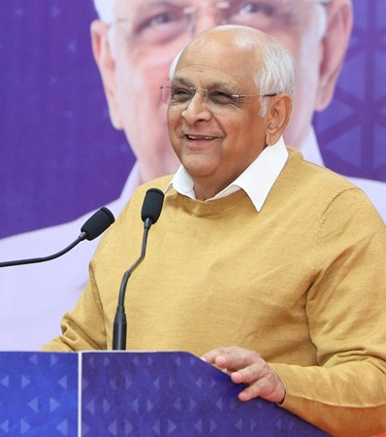
CM’s Vision:
Women farmers’ prosperity is essential for rural and agricultural growth.
"State’s responsibility: Recognition + Opportunities + Training + Technology."
Strategic Pillars:
Women-led Agriculture Policy – Special schemes tailored for women farmers.
State support for SHGs/FPOs – District-level subsidies & training.
Easy scheme access – Registration camps for women.
Skill-building centres – For value addition, animal husbandry, food processing.
Nutrition-linked farming – Kitchen gardens, millet-based cultivation.
Technology access – Solar dryers, pumps, women-friendly equipment.
District Model Farmers – 1,000 women role models per district.
Flagship Initiative – “Operation Sindoor”
Multi-dimensional empowerment through Krishi Sakhi, Pashu Sakhi, Van Dhan SHGs.

Slide 12
Status of Women Farmers (Before the Program)
Lack of awareness of sustainable farming practices and market opportunities.
Minimal contact with agricultural extension administrations, limiting access to knowledge and schemes.
Limited family support, restricting their participation in decision-making.
Additional responsibilities such as animal husbandry, family care, and household chores, leaving little time for skill development.
Exclusion from agricultural decision-making, despite active involvement in farming activities.

Slide 13

ONGC & NCCSD Model for New Farmers – Women Farmers.
5 districts, 10 villages each, 50 women per village – 2,500 beneficiaries.
Three-stage training + guidebooks + follow-up visits.
Partner with local NGOs/SHGs for implementation.
Feedback & field visits.
Progress tracking through structured reporting.

Slide 14

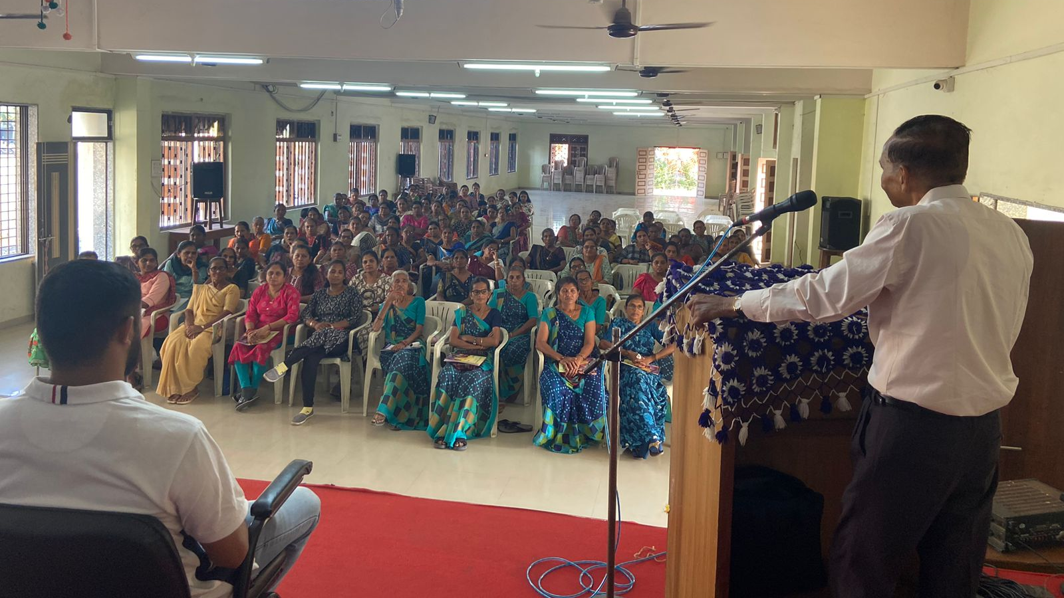

NCCSD Approach: Unique Features
Participatory planning – Women involved in topic selection & design.
Training & Follow-up at village & convenient timing – Balances domestic responsibilities.
Direct presence of government experts in each training.
Three-topic training guidebooks – Practical, illustrated, easy language.
Free meals & facilities during training.
Pre- & post-training reviews with experts.
Feedback & field visits for continuous engagement.
Coverage – 5 districts × 10 villages × 50 women × 3 trainings = 2,500+ women trained.
Multi-stakeholder model – State departments, experts, NGOs, NITI Aayog.

Slide 15

Drone Demonstration Program
Organized in collaboration with Optimus Unmanned Systems (Delhi based company). The program was conducted in four districts, where the team visited each district thrice to provide live demonstrations of the use of drones for agriculture. Through these drone demonstrations, women got to know about the Drone Didi scheme and also learnt about new technologies.

Slide 16

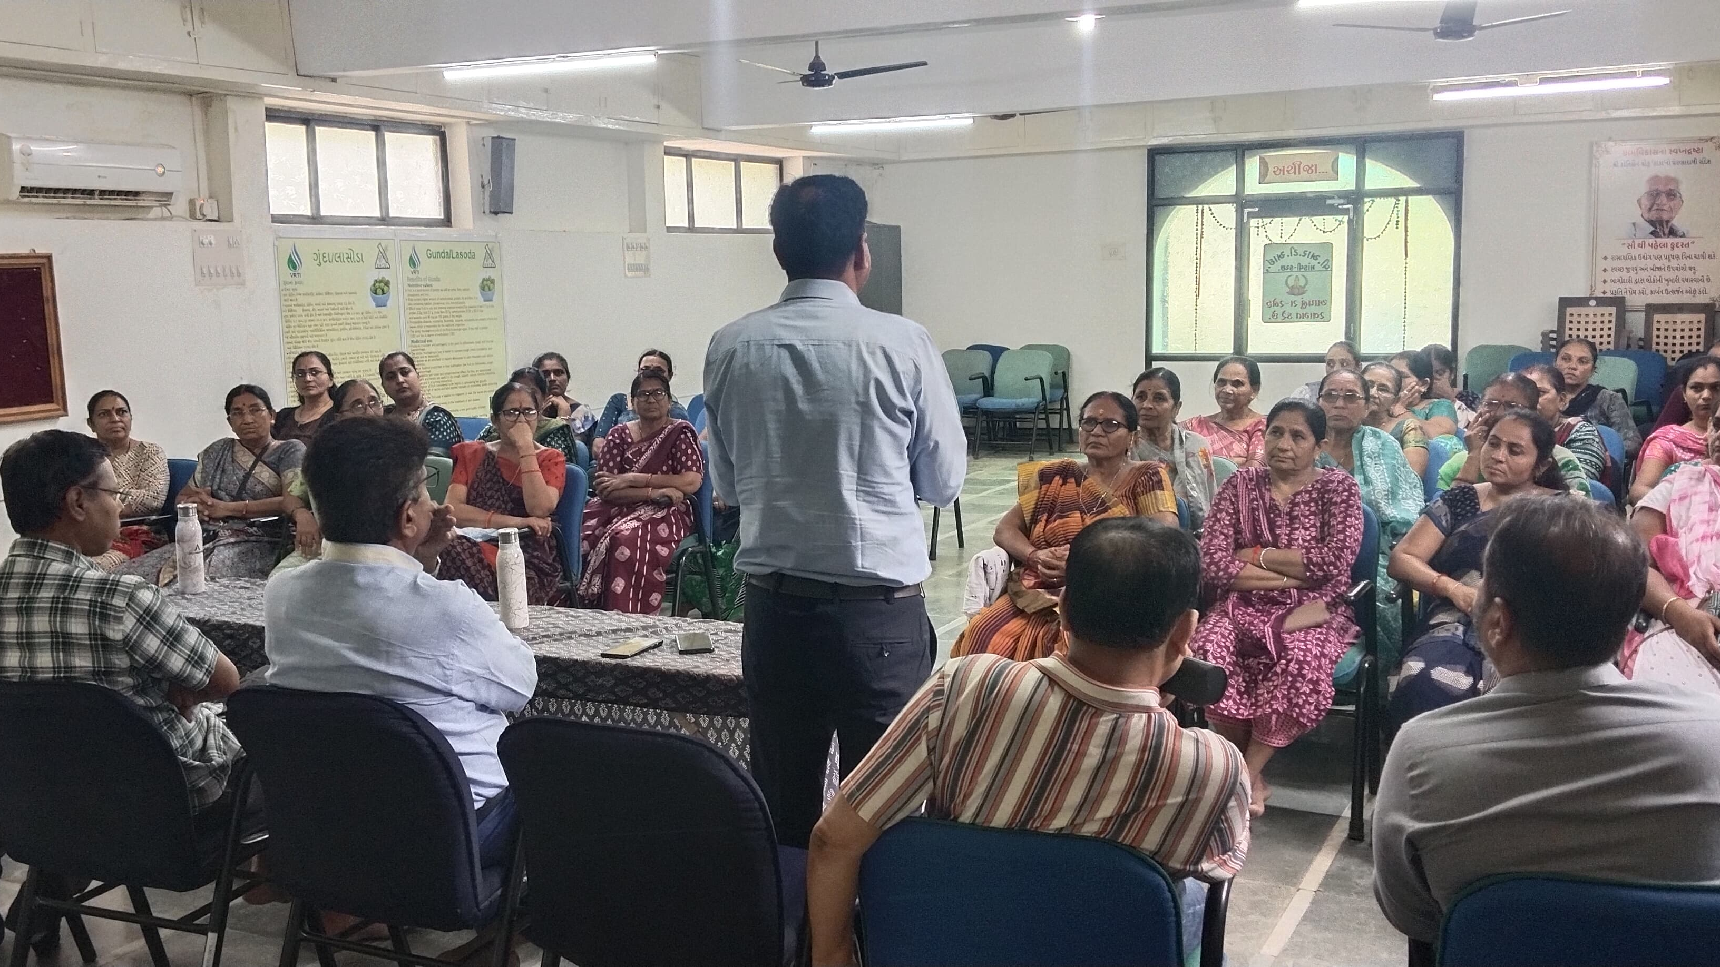
Financial Literacy Program
Special sessions were held for women farmers to guide them on how to access financial assistance and support schemes, enhancing their ability to secure resources for farming and entrepreneurship.
125 women leaders trained → 50 villages impacted
Key Outcomes
Financial literacy & digital banking confidence
Access to credit, subsidies & govt. schemes
SHGs & FPO participation strengthened
Adoption of solar, drip irrigation, food processing, dairy tech
Women launched new enterprises (e.g., khakhra, agro-businesses)
Impact: Empowered rural women → sustainable livelihoods & resilient communities

Slide 17
Key Partners and Contributors Supporting the Program
Institutions & Departments
Optimus Unmanned Systems
Panchayat
Krishi Vigyan Kendra (KVK)
District Agriculture Department
ATMA (Agricultural Technology Management Agency)
NABARD
Horticulture Department
Agricultural Universities (Vice Chancellors & Scientists)
CED Department
Government Leaders & Policy Makers
Shri Raghavji Patel – Hon’ble Minister, Agriculture, Animal Husbandry, Cow Breeding and Fisheries, Government of Gujarat
Hon’ble Shri Parshottam Rupala – Hon’ble MP (Lok Sabha) & Former Union Minister, Department of Fisheries, Animal Husbandry & Dairying, Government of India
Hon’ble Shri Dilip Sanghani – Chairman, IFFCO & GUJCOMASOL and Former Agriculture Minister, State of Gujarat
Dr. Anju Sharma, IAS – Additional Chief Secretary, Agriculture, Government of Gujarat
National & International Experts
Prof. Ramesh Chand – Hon’ble Member, NITI Aayog, Government of India
Dr. V. K. Saraswat – Member, NITI Aayog & Chancellor, Jawaharlal Nehru University
Dr. Neelam Patel – Senior Adviser (Agriculture), NITI Aayog
V. V. Sadamate – Former Advisor (Agriculture), Planning Commission, Government of India
Sanjay Deshmukh – Professor & Head, Life Sciences, Mumbai University
Prof. O. S. Mbuya – Director, Center for Water & Climate Institute, Florida A&M University,USA
Mr. Geoffrey Kirenga – CEO, SAGCOT Centre Ltd., Tanzania
Dr. Keshav Nayak – Former Director General, DRDO, Bangalore
Dr. S. S. Kalamkar – Director & Professor, Agro-Economic Research Centre for Gujarat
Shri Sandeep Kumar, IAS - Secretary (Co-operation, Animal Husbandry, Cow Breeding & Fisheries)
Dr. V. P. Chovatia -Vice Chancellor,Junagadh Agricultural University.

Slide 18




Ongoing Efforts by NCCSD
Guidebooks for Women Farmers
Cover 3 crop seasons with season-specific practices
Printing in Gujarati
Printing in English (work in progress)
Digital Success Stories
6 stories uploaded on Atmanirbhar SELF RELIENT NCCSD GUJARAT INDIA YouTube channel
More stories under preparation
Continuous Support
Handholding for adoption & innovation
Focus on awareness, confidence & decision-making

Slide 19
Success Stories
Amreli Shilpaben Bharatbhai Radadiya
Trained under ONGC–NCCSD project.
Started home enterprise making papad, wafers, pickles, and ghee.
Earns regular income and is a leader among women groups.
Bharuch Nahar Women Group (Ramilaben, Nayanaben, Parvatiben, Jayaben)
Started natural herbal soap making unit after training.
Use farm-based ingredients like neem, aloe vera & tulsi.
Their eco-friendly soaps are now in demand locally & nearby villages.
Bhavnagar
Mamataben Juvanbhai Dodhiya
Switched to natural onion farming on 1.5 vigha land.
Yield increased from 300 to 410 mann.
Reduced chemical costs, improved income, and became a confident community leader.
Navsari
Rinaben Chetanbhai Patel
Civil engineer turned entrepreneur.
Runs a beauty parlour and garment shop, providing jobs to other women.
Example of educated women leading rural entrepreneurship.
Kutch
Manjulaben Harilal Mawani
Adopted natural animal husbandry & farming.
Reduced costs by 25%, improved soil quality & milk yield.
Today, she is a mentor and guide for other village women.

Slide 20


Outcomes
2,761 women trained in sustainable farming & entrepreneurship.
Average 10% income increase.
15% reduction in farming costs through natural inputs.
350+ women join in FPOs.
15+ home-based enterprises started.
Increased decision-making power & market engagement.
Adoption of Pakrutik kheti, animal husbandry innovations, drones, soil kits.
Increased awareness among women farmers in agriculture.

Slide 21
District-Specific Focus & Achievements
District | Focus Area | Key Outcomes
Bhavnagar | Soil health, drone tech | 30% cost savings, better fertility, increased natural farming
Bharuch | Value addition, Natural farming | 6 enterprises started-products sold in local markets
Kutch | Animal husbandry, drought crops | Improved livestock health, reduced costs, climate-resilient crops
Amreli | FPO , home industries | 300+ women members in FPO, 20+ enterprises (papad, wafers, khakhra), higher incomes
Navsari | Horticulture, market access | Direct-to-market sales (pickles, Mango pulp, papad, tutty-fruity)

Slide 22
District-Level Variations & Need
Navsari & Bharuch – Higher awareness and greater adoption.
Bhavnagar & Amreli – Awareness exists, but more desire for adoption.
Kutch – Lack of awareness, need for capacity-building.
Action: District-specific strategies + cross-learning from high achievers.

Slide 23
Women & Agriculture: System Exists but Access is Limited
✅ Schemes Accessible to Women
Women SHG Loan Scheme – Local & easy access
Cow/Goat Assistance Scheme – Linked with animal husbandry
Ujjwala Yojana – Household-level gas connection in woman’s name
Widow/Old Age Pension – Social security support
Mukhyamantri Mahila Kisan Sashaktikaran Yojana – State-level scheme for training & tools
❌ Schemes Difficult for Women to Access
PM-KISAN – Land must be in woman’s name
PMFBY Crop Insurance – Awareness & registration barriers
KCC – Banking complexities, spousal consent
Solar Pump (PM-KUSUM) – High cost & online hurdles
Agri-Startup Subsidy – Certification & IT filing required
Drone/Fisheries Schemes – Digital & registration gaps
MKSP (NRLM) – Direct SHG support

Slide 24
Policy Suggestions: Empowering Women in Agriculture (Gujarat)
Key Focus Areas
Finance & Awareness – MMKSY (₹50,000 support), PM-KISAN inclusion, loan access via SHGs/FPOs
Women-Friendly Tools – Tool banks, labor-saving devices
Market & Climate Linkages – e-platforms, local language advisories
Animal Husbandry Tech – AI/IoT, women-run dairy cooperatives
Climate Services – SMS/WhatsApp updates, Agro Advisory Champions
Home-Based Industries – PMFME, SHGs for papad/pickles, branding & packaging
Market Logistics – e-NAM, cold storage, transport pooling
Time-Saving Household Tools – stoves, solar panels, water purifiers
Inclusive Policy (Nari Gaurav Policy 2024)
Flexibility in land ownership
Digital inclusion
Integrated schemes
Key Stakeholders State & Central Govts., Panchayats, SHGs, FPOs, NGOs, Tech Companies

Slide 25
Department-wise Policy Suggestions
Agriculture Department
Women Farmer Support Centers in every taluka
Subsidies & training for women-friendly tools
Animal Husbandry Department
Digital livestock management training
Support women-run dairy cooperatives
Rural Development Department
Women FPOs, SHG-based enterprises
"Time-Saving Tool Kits" distribution
Women & Child Development Department
Agriculture-based life skills training
Schemes for pregnant/lactating women
Industries & MSME Department
Special subsidies under PMFME
Machinery & market platforms for women
IT & Digital Inclusion
Women Farmer Mobile App (local language)
Digital Vans & literacy programs
Meteorology Dept. / KVKs
Local weather advisories via SMS/WhatsApp
Women Weather Assistants
Marketing & Transport Dept.
"Market-Milap" platform for direct sales
Subsidized cold storage & transport pooling
Cooperative and APMC
Rotation system exists in Local bodies Gram Panchayat for chairperson – same need to be introduced in Cooperative and APMC by statutory amendments

Slide 26


Thank You

