Slide 1


Natural Farming for Combating Climate Change
By
Dr. Kirit Shelat, I.A.S. (Retd)
Executive Chairman
National Council for Climate Change, Sustainable Development
and Public Leadership (NCCSD)-Ahmedabad

Slide 2
Introduction
Alternative low-input farming practices have emerged in India and across the world likely to reduce input costs and higher yields for farmers, chemical-free food for consumers and improved soil fertility.
Natural Farming is one such low-input, climate-resilient farming that inspires farmers to use low-cost and locally-sourced and available inputs, eliminating the use of artificial/chemical fertilisers and industrial pesticides.

Slide 3
Natural Farming
An approach towards sustainability
Expense-free farming
Farming up to 30 acres with one native cow
Farming with minimum electricity and water consumption
Producing quality food
Agriculture without external input
Techniques of multi-crop cultivation for higher net income
Reducing external labour requirement
Farming in tune with nature
Saving the farmers from suiciding themselves and leaving behind their families as beggars.

Slide 4
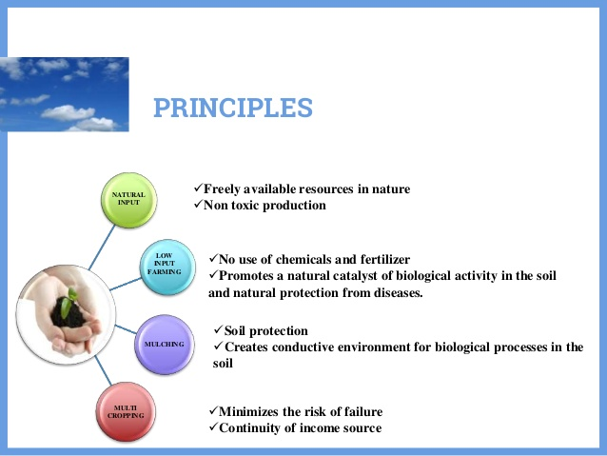

Slide 5
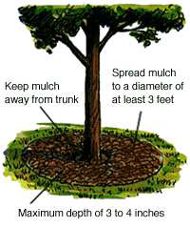
Soil mulching
It is necessary to create the microclimate under which micro-organisms can well develop, that is 25 to 32 °C temperature, 65 to 72 % moisture.
It creates darkness and warmth in the soil.
It conserves humidity of the soil, cools it and protects its micro-organisms.
Mulching promotes humus formation, suppresses weeds and maintain the water requirement of crops.

Slide 6
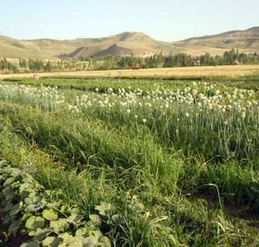
Multicropping
Multicropping is a good way to minimize the risks for the farmer who is able to enjoy continuity of yield throughout the year.
In case of a main crop’s failure he can also rely on the other crops.
It has expanded farmers’ income sources.

Slide 7
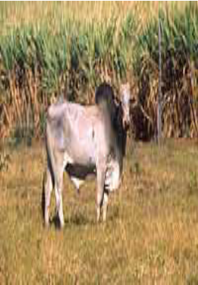
Importance of Indigenous Cow
One gram of desi cow dung contains 300 to 500 crores of beneficial effective microbes.
Micro-organisms decompose the dried biomass on the soil and make available the nutrients to the plants.

Slide 8
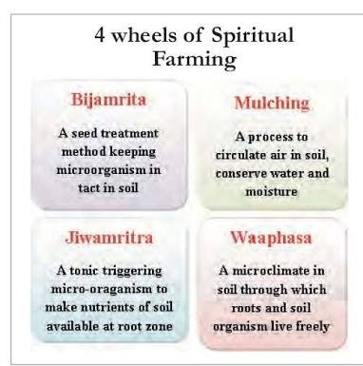

Slide 9
Bijamrutha
It is a mixture of water, cow dung, cow urine, lime and forest soil which is used to treat seeds, seedlings or any planting material which protects from soil and seed borne pathogens.

Slide 10
Jivamrutha
It is a mixture of water(200L), cow dung(10kg), cow urine(10L), jaggery (unrefined brown sugar), flour of any pulse when applied over soil promotes biological activity and adds soil microbes.
It acts as a catalytic agent to promote biological activity thereby breaks the nutrients available in the soil by increasing soil microbes.

Slide 11
Waaphasa
If there is no Waaphasa (soil aeration) in the soil, the plants will die.
For this, water is sprayed on degradable materials that are allowed to remain on the farmland.
This forms humus that helps retain the moisture and nutrients in the soil.
Farmers need to draw only 10 per cent of the required water from the soil for cultivation using this method.

Slide 12
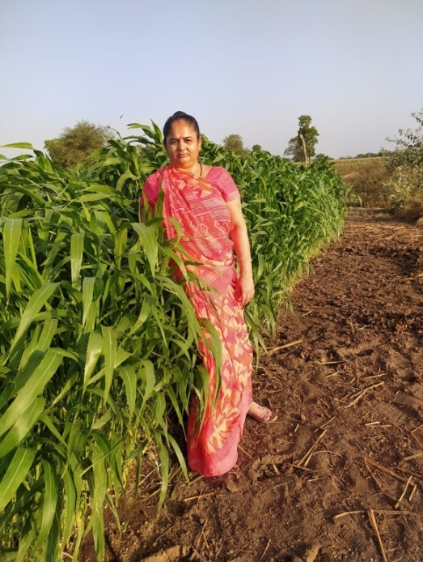
Success Story: Alkabben Jitubhai Sojitra
Village: Dhareshwar | Taluka: Rajula | District: Amreli | Age: 48 Occupation: Farming & Household Work | Education: 7th Pass | Experience: 14 Years
Initial Situation: Cultivated chickpeas on 5 vighas; yield 75 maunds (₹72,000 income). High input costs due to chemical use and issues like unseasonal rain and labor shortage.
Training by NCCSD: Received training in natural farming, animal husbandry, and organic inputs (Jivamrut, Amrutpani, Dashparni Ark, Neem Oil). Learned about government schemes and modern tools.
Results: Adopted natural farming → Yield increased to 125 maunds. Income and confidence rose; became an inspiration for other women farmers.
Key Message: With training, guidance, and confidence, farming can be profitable and empowering.

Slide 13
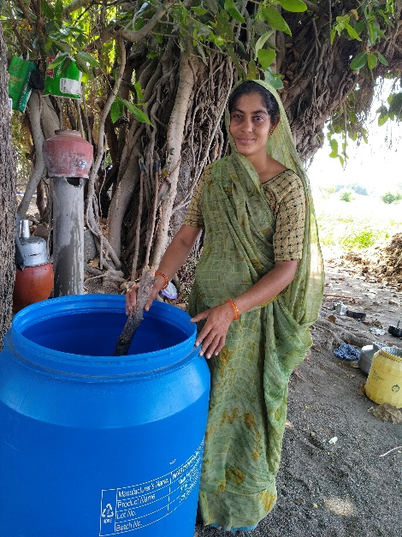
Success Story: Mamataben Juvanbhai Dodiya
Village: Agiyali | Taluka: Shihor | District: Bhavnagar | Age: 35 Occupation: Farming & Household Work | Education: 7th Pass | Experience: 10–12 Years
Initial Situation: Cultivated onions on 1.5 vighas – 300 maunds yield (₹50,000 income). High chemical cost, unseasonal rain, and labor issues.
Training by NCCSD: Learned natural farming, organic inputs (Jivamrut, Ghanjivamrut, Amrutpani, Dashparni Ark, Neem Oil), and government schemes.
Results: Adopted natural farming → yield rose to 410 maunds. Improved income by crop sorting and market-based selling.
Impact: Boosted self-confidence and leadership; motivates other women.
Key Message: Proper training and confidence make farming profitable and empowering.

Slide 14
CASE STUDY-“Zero Waste Village” by Solid and Liquid Waste Management” Genesis:
Khanderaopura village (Padra block of Vadodara District, Gujarat)is a village having population of 1500 having 185 households.
In 2016 this village had an outbreak of Cholera and it earned a bad name.It remained focus of media for a long period. Shroff Foundation Trust was requested to look in to the problems of sanitation & hygiene of this village.
Thus, it was decided by the village community that this village would need to be qualified for ODF and the drainage line would be repaired to make it functional.

Slide 15
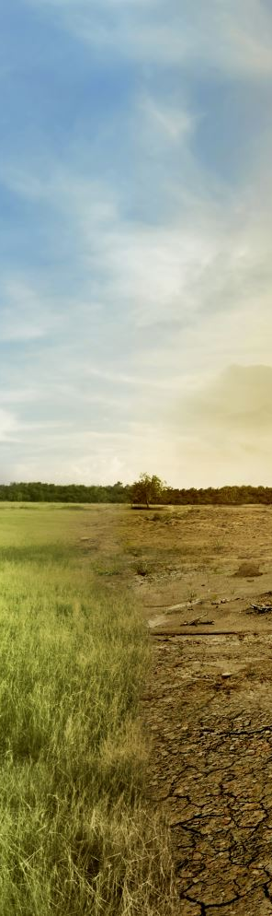
CASE STUDY -Use of Technology –City Sewage Treated and Recycled for Agriculture
Jalna is a city located in Marathwada and receives very less rainfall and is drought prone area. Having population of around 3.0 lakhs, availability of domestic sewage is sufficient including in summers. Farmers of Jalna here facing shortage of water for agriculture and therefore it was decided to treat the city sewage (from nearby nallah) through Bioflter Technology and reuse for agriculture. Since then the farmer are able to take 3-4 crops per year and their problem of water shortage was completely resolved.

Slide 16
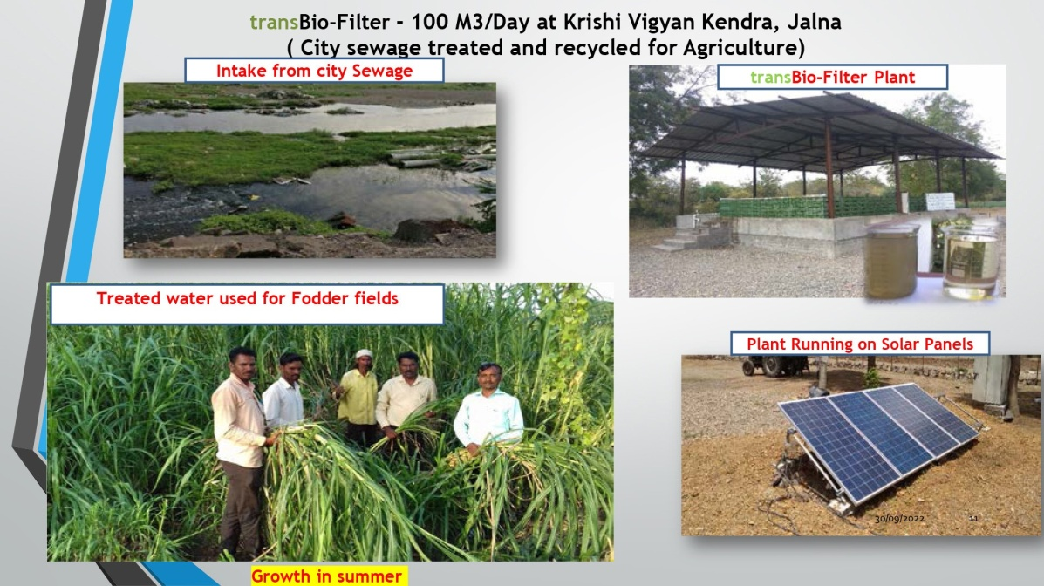
Contd….

Slide 17
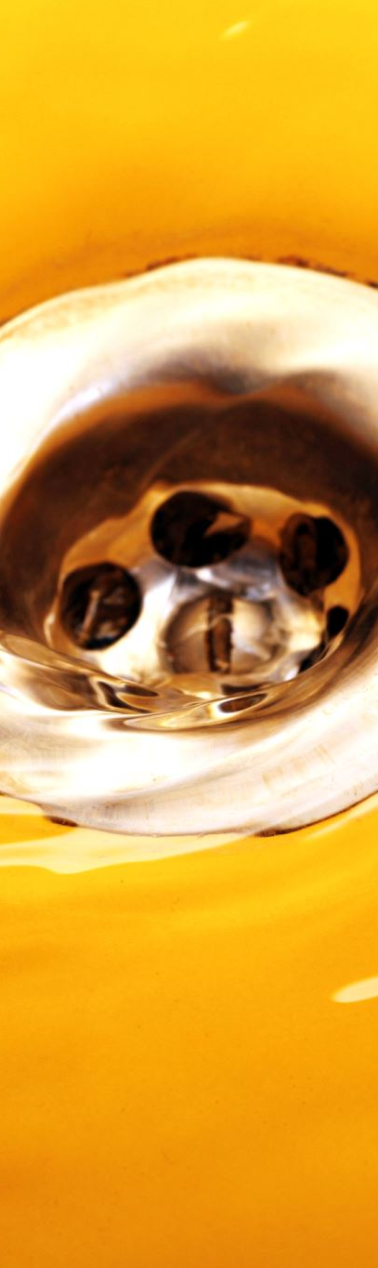
Introduction to Rural Liquid Waste Management
The Jal Jivan Mission (2019) provide for minimum 55 litres per capita per day (LPCD) supply of water through tap. Half of the States are providing 70 litres or 100 litres LPCD. Considering 65% of it is generated as waste, the grey water (including blackwater) would be in the range of 40 to 60 LPCD.
Thus, 1000 population would generate an average 50 KLD (taking in to account for next 5 years).
Treatment of wastewater is a big challenge. The big central treatment plants have proved to be ineffective because of the high cost of operation, increasing load of pollutants, inadequate technology, and very high capital costs.
Bio-filters technology qualifies to be a decentralised effective, efficient, cost-effective system for addressing the issues flagged above.
The treated water has added nutrients worth (Rs. 1.60 per thousand litres) and is acceptable for Agriculture, land scape as per CPCB norms of 2017. The nutrient rich water can fetch Rs.2.00 per thousand litres.
The treated water supply supplements dwindled water supply in summer to support summer crops.

Slide 18
Contd….
The indirect benefit is also equivalent saving of extraction / distribution expenditure of Agriculture Water (Rs.5/- to Rs. 10/- per thousand litres depending on source and distance of transport).
Ultimately, Waste Water Treatment is crucial for reducing pollution load in ground water and streams & rivers.
Bio-Filter technology also obviate the generation of sludge and hence its management, it also can handle black water (septic tanks).

Slide 19
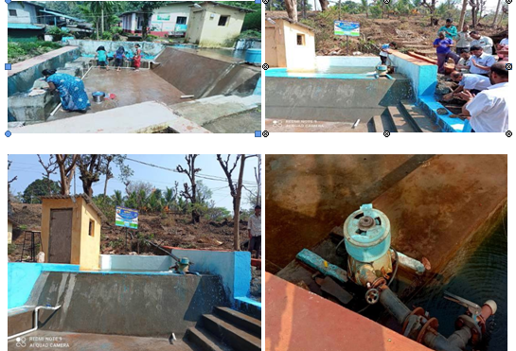
Village Level Hydro Power-Maharashtra

Slide 20
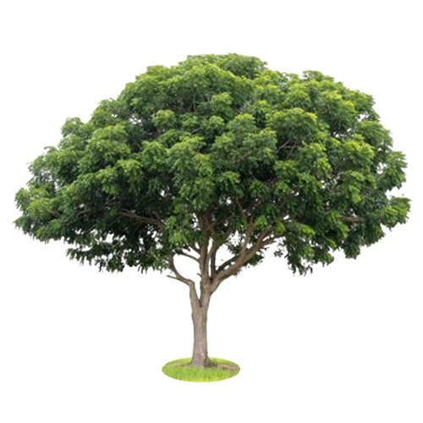
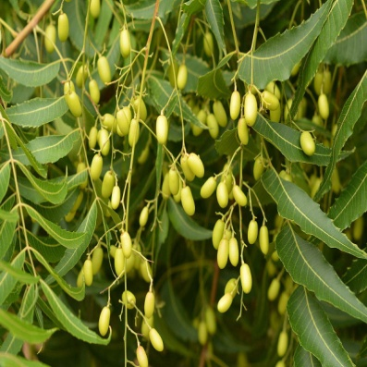
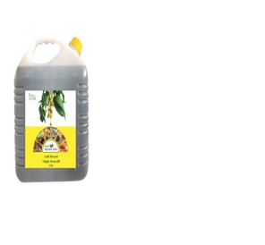
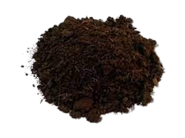
Azadirachta indica (Neem): A Multiutilities Tree
Azadirachta indica, commonly known as neem has cultural significance in India
It grows exuberantly in drought-prone areas giving cool shade and therby is a good anti-desertification tool with good carbon dioxide sink to sequester around 1.45 lakh tons carbon/tree with a girth of around 15-30cm. .
It is also used for maintaining soil fertility. Fertilizer: neem extract is added to fertilizers (urea) as a nitrification inhibitor. Neem leaves can be occasionally used as forage for ruminants and rabbits.
Neem cake is dense with several micro and macronutrients. Unlike a chemical fertilizer, Neem cake releases those nutrients gradually into the soil with plants having adequate time to use them as nutrition.
Being natural, it is compatible with soil microbes and rhizosphere microflora. It acts as a nitrification inhibitor, and slows down the conversion process of nitrogenous compounds in ammonia, nitrates, and nitrites.
It is bio-degradable and can be used with many other different types of fertilizers.,
Oil Cake

Slide 21
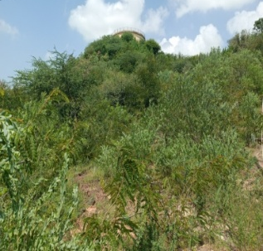
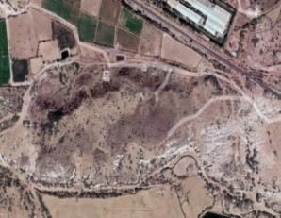
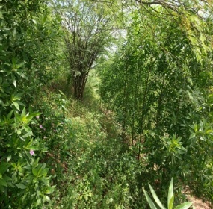
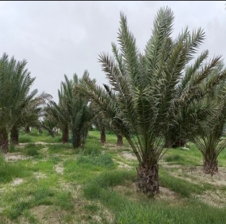

Greening The Earth ,Hill 1-18,000and HILL -2 35000
In Kutch the area where Rann of kutch located in state of Gujarat and salt is produced. AGROCEL is involved in salt production and bromine.
Experiments growing of plants in molded areas within salt extraction areas, with proper rain water harvesting and soil management .
Hill 1 started in 2017, with the belief that water from Panchayat would become available for raising saplings. Alas! it did not and the stray cattle were the biggest nuisance. As if this was not enough, the land was eroded to last grain of the soil such that it has exposed even the bed Rocks. The odds did not dampen the resolve to green the hill, pits were dug and filled with soil, organic matter and Zeba that increases the water holding capacity of soil and helps in the reduction of leachates and associated contaminants to the environment. The retained moisture in the soil is also beneficial to the crops and the soil microbiome. Water was managed from leakage and only nongrazing species like Kasid, Karanj were planted. The efforts have transformed the hill-1, it is totally green now entailing over 18,000 plants and lot many diversity has come up on its own. This encouraged the attempt at Hill 2, that was more obstinate than Hill 1.
on Hill 2 like impregnation of seed pallets were adopted but it failed miserably draining both moral and investments. Took help of Panchayat, villagers for creating a feeling of “Joint Ownership”. Contour terracing was done in second attempt from top, water harvesting was done in 5 ponds and pumping of water was done from base of the hill water storage structure and planted 85 different species in 9 blocks. It was successful and till this monsoon, it had 35000 odd plants growing exuberantly.
Hill in 2017 and now
Salty pan growing quality dates

Slide 22
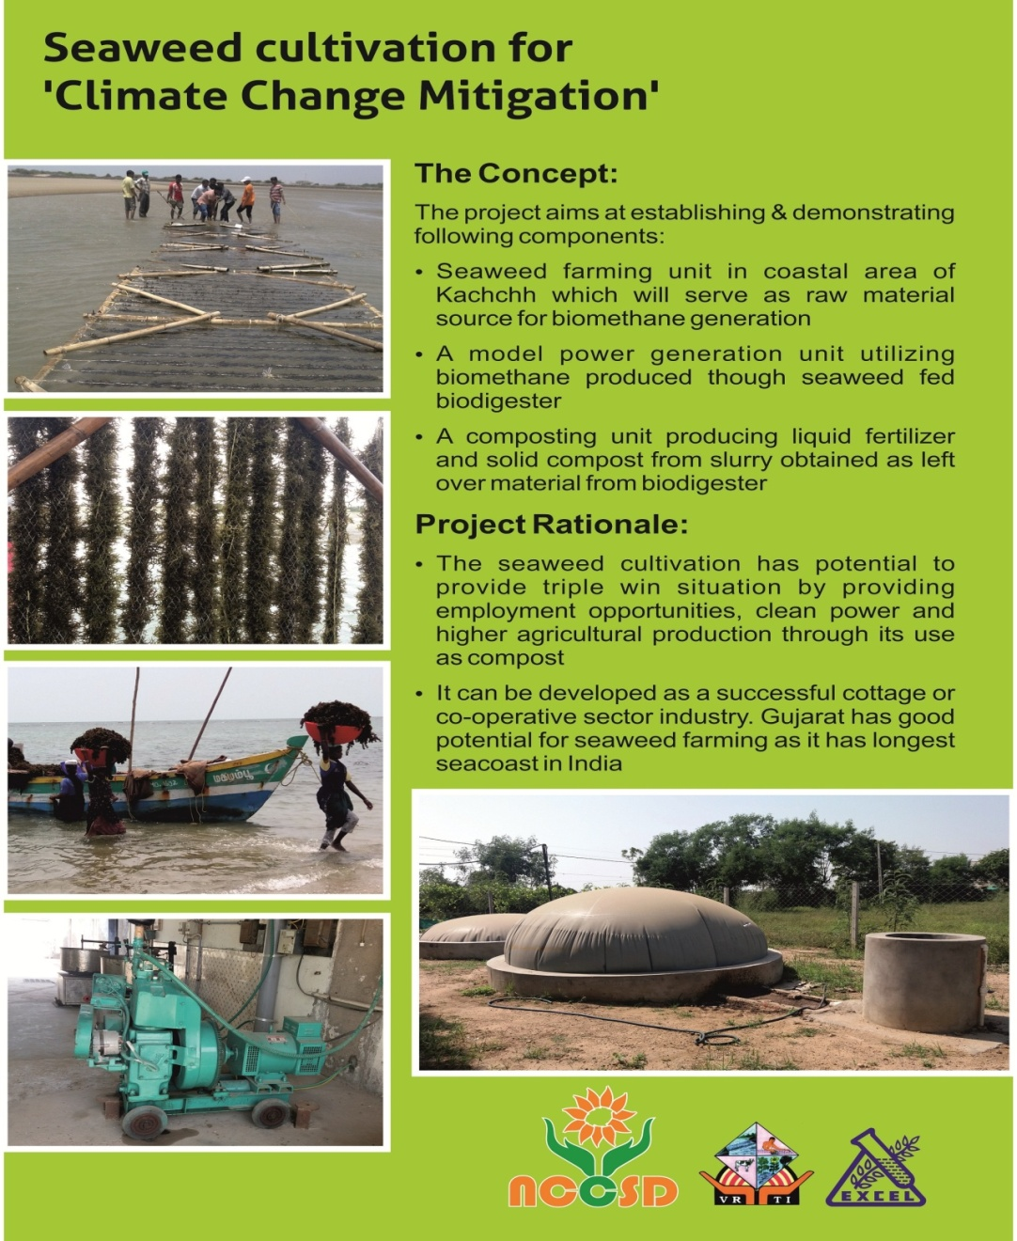
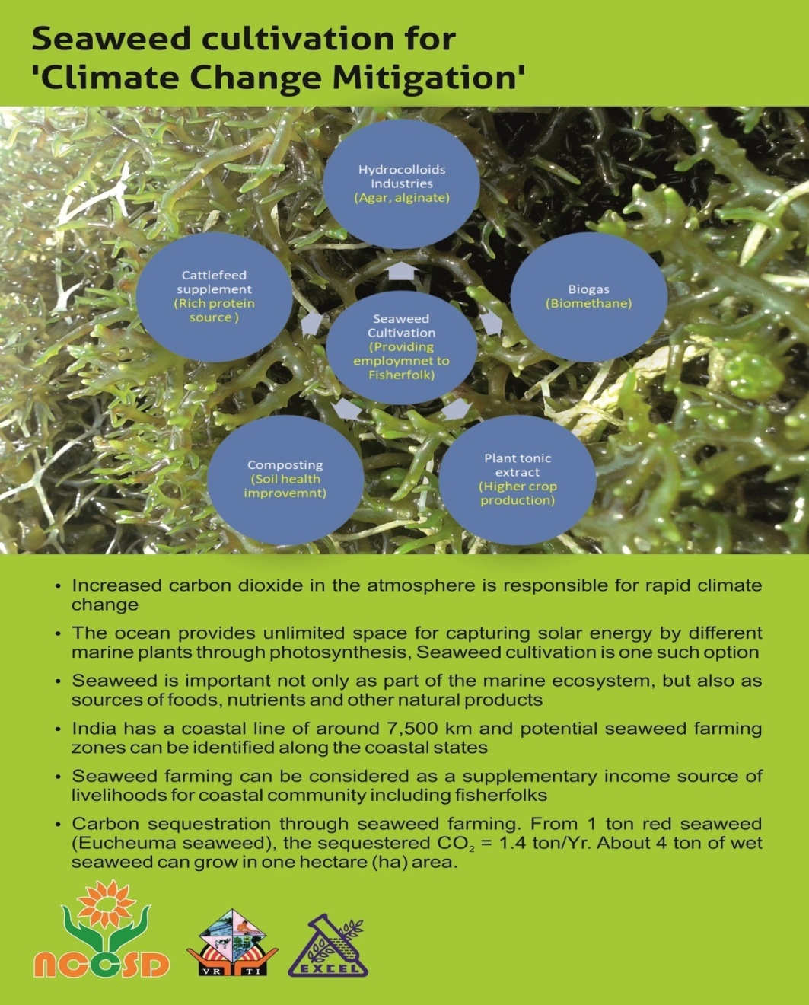
Seaweed Cultivation

Slide 23
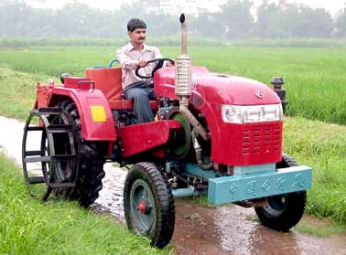
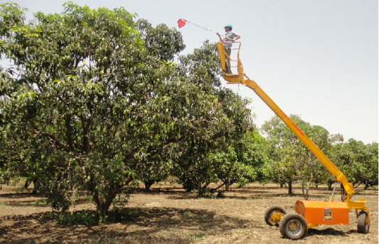
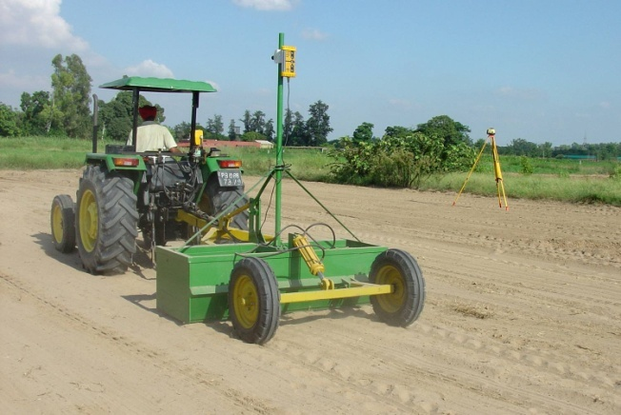

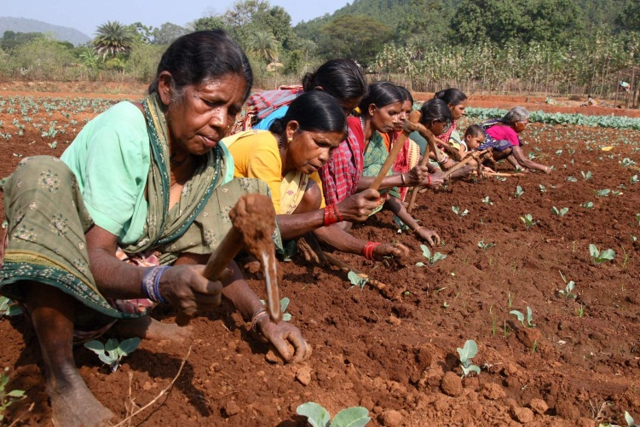
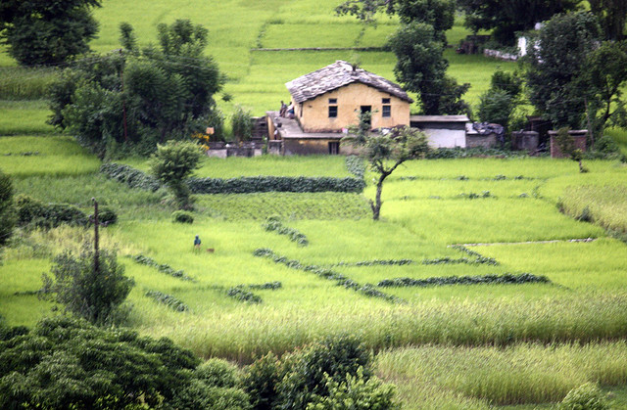
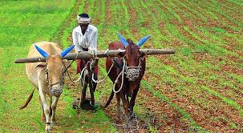
envision smart farming & enable small farmers

Slide 24
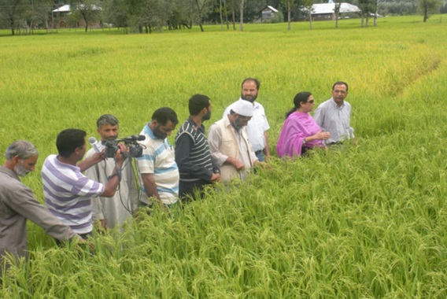
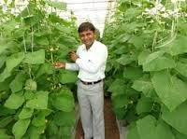
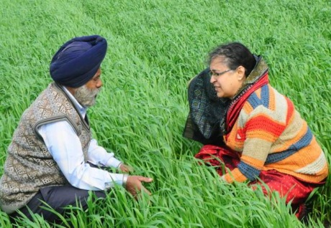
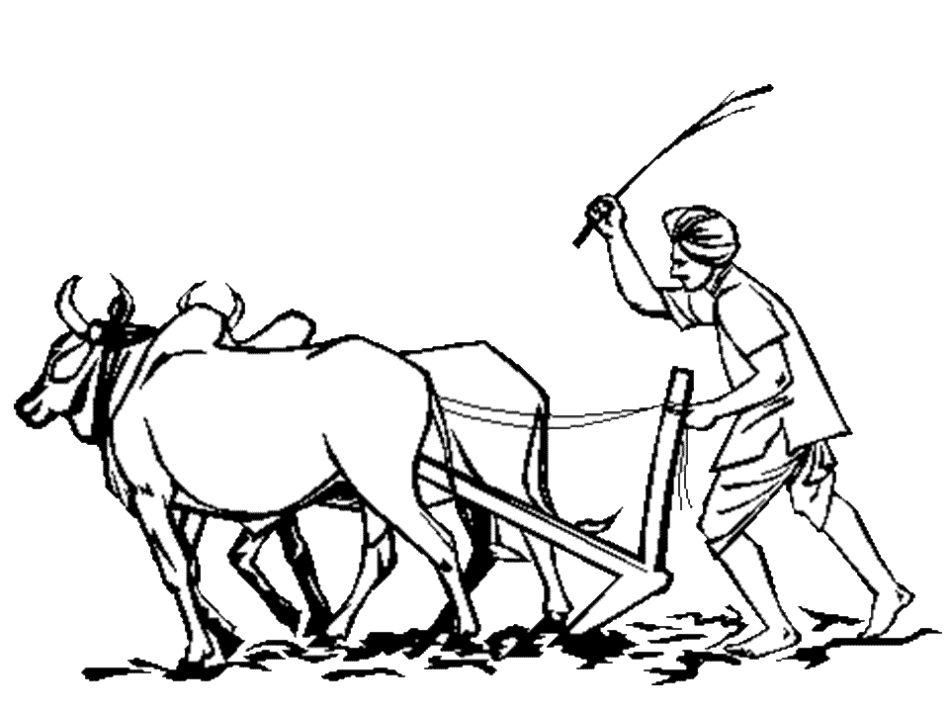

मेरा गाँव मेरा गौरव
Scientists, as Social Change Agents

Slide 25
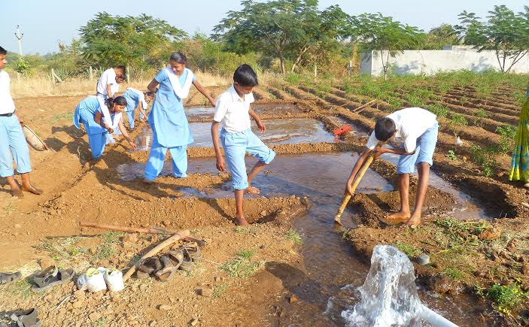
Skilling Indian Youth……..

Slide 26
Dr.Kirit Shelat, I.A.S.(Rtd.) Executive Chairman – NCCSD
National Council for Climate Change Sustainable Development and
Public Leadership (NCCSD) Patel Block, Rajdeep Electronic's Compound, Near Stadium Six Road, Navrangpura, Mobile: 091 9904404393 Email: drkiritshelat@gmail.com
Website: www.nccsdindia.org

