Slide 1



Future Agriculture
Women Farmers – New Farmers – Sustainable
Livelihood & Development with Technology
National Council for Climate Change Sustainable Development and Public Leadership (NCCSD)
Patel Block, Rajdeep Electronic's Compound, Near Stadium Six Road, Navrangpura, Ahmedabad-380 014 Website: www.nccsdindia.org

Slide 2
Women Farmers – New Farmers
Future Agriculture in Viksit Bharat
1. Structural Change at the Family Level in Rural Areas
Traditionally, men take all farming decisions while women contribute labour – treated as workers.
With men increasingly migrating to semi-urban and urban areas for work and youth for studies, in many areas, women are now emerging as the ‘New Farmers’ and have to become responsible for day-to-day agricultural decisions.
Women are not well-informed about current agricultural practices – technology and assistance available.
Extension Administration does not contact them.
Their mobility outside village is limited.
Majority of them do not have smart phones.
2. Structural Change in Agriculture Sector
Climate change and unpredictable intense adverse weather events need continuous guidance and farmer-specific contingency planning – productivity is under challenge – so is livelihood.
Shrinking farm size make viability a challenge; while technologies for tiny farms exist, it remains inaccessible to most farmers.
Increasingly “Sharecroppers” are growing in peripheral areas of Urban – Semi Urban towns which is a major challenge to productivity. This is different from sugar cane farming. Land is sold – but not developed by speculators and hence sharecroppers.
Salinity ingress and water contamination - in tubewells and canal water further aggravates the situation, threatening both crops’ livestock and drinking water – productivity and health. Ocean areas already face serious challenges.
Adaption of Prakrutik Kheti is need of time – due to soil degradation and increasing cost of chemical inputs.

Slide 3
3. Support Women farmers for VIKSIT BHARAT.
In VIKSIT BHARAT, Agriculture Sector is a major strength. India, with world’s second largest arable land and adaptive farmers can supply World Food and Food Security as it already did during arena of COVID.
But to make this happen Agricultural Administration and Universities have to make a paradigm shift in their focus.
Women already look after livestock and understand its use and more adaptive and willing to pick up new ideas. But they need to be informed and guided by demonstration an up-skilled for New Technologies and emerging climate change situation and market trends – more particularly:
Water Resilient Agriculture
Smart use of Water and Solar System.
Digital use – For application for Subsidy & Loan and Market & Procuring inputs.
Soil & Water analysis-based Crop Selection
Weather Advisory based farming and climate smart agriculture.
Use of Drone
Precision Agriculture
Tissue Culture
Contingency plan in case of severe adverse weather events.
4. Women Farmers need Attention and Support:
Extension Administration and Agricultural Universities must reach out to them at village level.
Financial support by Bank.
In village records – from VII – XII; they should be recorded as farmers and also in census as well in succession – VARSAI entries.
Support for smart phones and setting up of cooperatives / FPO
Guidance for –
Selection of inputs
Weather events & Climate Smart Agriculture
Harvesting and Storage
Marketing & Value addition

Slide 4
5. Social Transformation – Ease of doing Business for Women:
Structural change in family in Decision-taking process needs to be facilitated – by appropriate social media messages in TV, Newspapers, Radio and social media. Family must realise that they have to support and make it easy for them to work and decide.
Technology – tools and equipments are Men-centric. They have to be Women-centric also – but more importantly made available at village – block level.
Rotation system exists in Local bodies Gram Panchayat for chairperson – same need to be introduced in Cooperative and APMC by statutory amendments.
6. Learning from Gujarat’s Experience
Under the Krishi Mahotsav Approach, initiated by Hon’ble Prime Minister Shri Narendra Modi (then Chief Minister of Gujarat), the state successfully overcame the challenges of low productivity.
Today, Gujarat stands as a leading Agricultural, Animal Husbandry & Fisheries state, demonstrating how structured interventions can turn adversity into opportunity.
Gujarat Women have already made successful AMUL model. They look after 100 per cent livestock management and are adaptable but need to be up-skilled and supported.
In Viksit Bharat approach is to have increasing income of rural family on par with their urban counterparts -This will need of male member to work in non-agriculure farm work - within or outside villages.

Slide 5
Way Forward: Viksit Bharat – Atmanirbhar Farmers
Hon’ble Prime Minister has laid a roadmap for agriculture in his Independence Day address as part of Viksit Bharat.
With women farmers at the centre, a comprehensive national program is needed to address emerging challenges.
The Krishi Mahotsav model can be adapted for mass communication, awareness creation, and implementation.
Request to ONGC – to support Second phase of this program.
Request to NITI Aayog: Take this idea forward and design a framework for nationwide adoption.

Slide 6
Department of Agriculture has all below Schemes, which are very good – but non-implementable.
Some Public Governance Issues:
Drone Scheme:
However, this scheme is very useful. Farmers save input cost. Drone has limited battery life and need a transport to carry them. Drone application is limited to one or two forms - thereafter, have to be taken back for charging. Transport is expensive. Hence scheme is structurally defective. Perhaps can work if State Agro Industries Corporations can take this up under Tool Room Scheme and make available al local level – inclusive of transport and charger.
APMC - Cooperatives:
One relates to sale of produce – second, Milk Producers Societies. Women have no representative in the Management Committee Board. They need to be made part of Governance System on par with local bodies where by rotation women are becoming Sarpanch, District Panchayat President.
Solar Scheme:
The scheme for sale of surplus electricity, generated in farms, is most viable and provide assured income but it is not possible for all villages to connect to grid – and therefore, no sale takes place unless there is a local Sub-station – hence it is not feasible to sell electricity to Electricity Companies. Hence scheme has very limited impact although it is most useful and most environment friendly.
Kisan Credit Card:
Women are not given this – despite there is provision to give them without being a land owner.
FPO Scheme:
This is again structurally defective scheme. MD – Chairman runs the organization – but has no higher stake in investment as it is in Limited Companies where promoter has a high stake and investment. Again, once promoter becomes MD, rest of members have no say in Management and there is no rotation system.

Slide 7
Further there is no Apex body as it exists in AMUL model. It is good scheme but - has not taken off.
Agriculture Research Centres both of ICAR and State Agricultural Universities are doing well. But major issue is that they do not follow guidelines of Climate Resilient Agriculture, there is no smart use of water by drip nor solar energized equipments. Farmers voice this when we ask them to follow climate smart agriculture practices. Many centres even do not test soil and water

Slide 8
Background
Agriculture contributes 16% to India’s GDP and is increasingly a women-centric activity.
70–80% of rural women workers are engaged in farming or allied agricultural activities.
Women play a key role in sowing, weeding, harvesting, threshing, grain storage, fisheries, animal husbandry, and sometimes marketing.
In rural India, women form the most productive workforce, especially in developing regions.
Male outmigration for jobs and youth leaving villages for education → farming responsibility shifting entirely to women.
Women are now decision-makers, not just helpers → must be recognized as “New Farmers.”
Yet, most are officially identified as “Workers ” (in census report) not as “farmer.”

Slide 9
Status of Women Farmers in Agricultural
Data Snapshot
Indicator | Status
Rural women engaged in agriculture | >73%
Women with legal land ownership | 12.8%
Women with Kisan Credit Card | <7%
Women members in FPOs/PACS | <10%
Women with access to crop insurance | <5%
Women receiving agriculture training | <10%
Source: NSSO, NABARD, Agriculture Census, FAO

Slide 10
Status of Women Farmers (Before the Program)
Lack of awareness of sustainable farming practices and market opportunities.
Minimal contact with agricultural extension administrations, limiting access to knowledge and schemes.
Limited family support, restricting their participation in decision-making.
Additional responsibilities such as animal husbandry, family care, and household chores, leaving little time for skill development.
Exclusion from agricultural decision-making, despite active involvement in farming activities.

Slide 11

ONGC & NCCSD Model for
New Farmers – Women Farmers.
5 districts, 10 villages each, 50 women per village – 2,500 beneficiaries.
Three-stage training + guidebooks + follow-up visits.
Partner with local NGOs/SHGs for implementation.
Feedback & field visits.
Progress tracking through structured reporting.

Slide 12

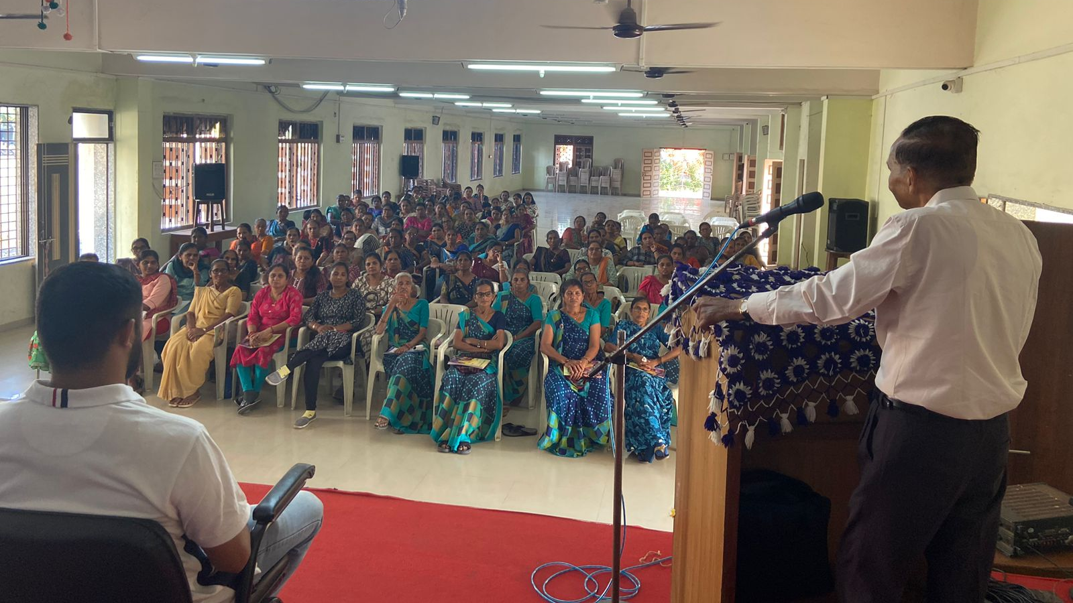

NCCSD Approach: Unique Features
Participatory planning – Women involved in topic selection & design.
Training & Follow-up at village & convenient timing – Balances domestic responsibilities.
Direct presence of government experts in each training.
Three-topic training guidebooks – Practical, illustrated, easy language.
Free meals & facilities during training.
Pre- & post-training reviews with experts.
Feedback & field visits for continuous engagement.
Coverage – 5 districts × 10 villages × 50 women × 3 trainings = 2,500+ women trained.
Multi-stakeholder model – State departments, experts, NGOs, NITI Aayog.

Slide 13
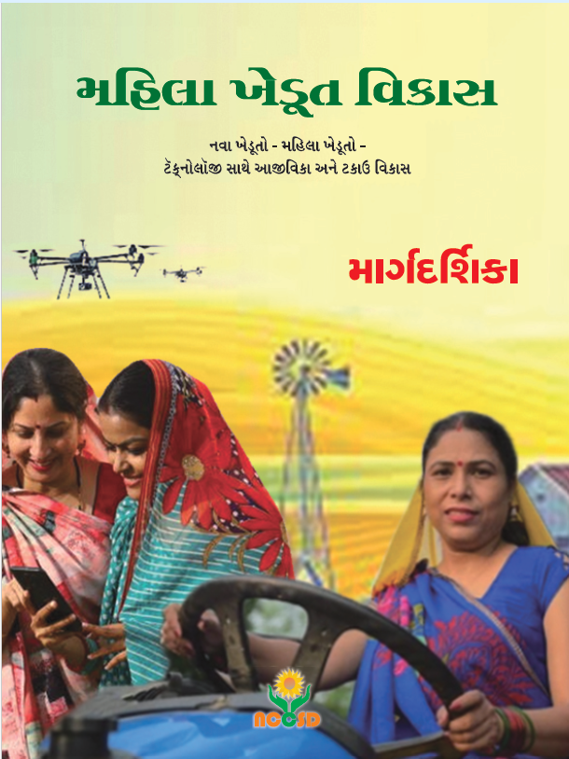

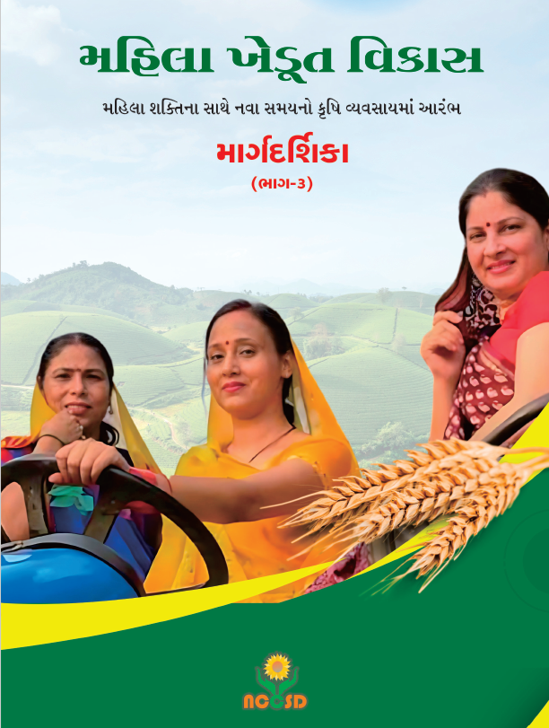

Ongoing Efforts by NCCSD
Guidebooks for Women Farmers
  Cover 3 crop seasons with season-specific practices
  Printing in Gujarati
  Printing in English (work in progress)
Digital Success Stories
  6 stories uploaded on Atmanirbhar SELF RELIENT NCCSD GUJARAT INDIA YouTube channel
  More stories under preparation
Continuous Support
  Handholding for adoption & innovation
  Focus on awareness, confidence & decision-making

Slide 14


Outcomes
2,761 women trained in sustainable farming & entrepreneurship.
Average 10% income increase.
15% reduction in farming costs through natural inputs.
350+ women join in FPOs.
15+ home-based enterprises started.
Increased decision-making power & market engagement.
Adoption of Pakrutik kheti, animal husbandry innovations, drones, soil kits.
Increased awareness among women farmers in agriculture.

Slide 15
Policy Suggestions: Empowering Women in Agriculture
Key Focus Areas
Finance & Awareness – MMKSY (₹50,000 support), PM-KISAN inclusion, loan access via SHGs/FPOs
Women-Friendly Tools – Tool banks, labor-saving devices
Market & Climate Linkages – e-platforms, local language advisories
Animal Husbandry Tech – AI/IoT, women-run dairy cooperatives
Climate Services – SMS/WhatsApp updates, Agro Advisory Champions
Home-Based Industries – PMFME, SHGs for papad/pickles, branding & packaging
Market Logistics – e-NAM, cold storage, transport pooling
Time-Saving Household Tools – stoves, solar panels, water purifiers
Inclusive Policy (Nari Gaurav Policy 2024)
Flexibility in land ownership
Digital inclusion
Integrated schemes
Key Stakeholders
State & Central Govts., Panchayats, SHGs, FPOs, NGOs, Tech Companies

Slide 16


Thank You

